Slide 1

Deliver your datacentre migration project successfully
Sarah Lean
Senior Cloud Advocate
Microsoft
@Techielass
www.techielass.com

Slide 2



Who am I?
Cloud Advocate @ Microsoft
Blog at www.techielass.com
@Techielass
Founder of the Glasgow Azure User Group
STEM Ambassador
14+ years in the IT industry
IT Pro

Slide 3
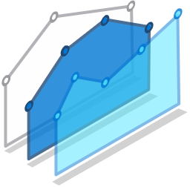

Migration Triggers
Cybersecurity threats
Cost efficiency & resource constraints
Fragile on-premises operations
Why are customers migrating?
Supporting remote work models
Meeting surge demand

Slide 4

Migration stages
Discovery
Assessment
Migrate
Secure and manage
Foundational best practices: People | Process & Planning | Technology

Slide 5
Discovery Stage
Microsoft Azure | @Techielass

Slide 6

Tooling
Microsoft Azure | @Techielass

Slide 7




Cost
How much does your existing environment cost?
What would it cost in the cloud?
Azure Pricing Calculator - https://bit.ly/3dFpZqh
Total Cost of Ownership Calculator - https://bit.ly/3dHAYQe
Cloud Cost Optimisation - https://bit.ly/2Bk7kTT

Slide 8
Assessment Stage
Microsoft Azure | @Techielass

Slide 9
Resource Management
Define Azure Management Groups & Subscriptions model
RACI
Define resource consistency roles & responsibilities
Define Resource Consistency Policies
Microsoft Azure | @Techielass

Slide 10

Migrate Stage
Microsoft Azure | @Techielass

Slide 11
Tooling
Microsoft Azure | @Techielass

Slide 12
Iterate and learn
Microsoft Azure | @Techielass

Slide 13

Secure & Manage
Microsoft Azure | @Techielass

Slide 14

Cost Management
Microsoft Azure | @Techielass

Slide 15
No migration is ever linear or simple…. Azure
Security and compliance
Migration plan
Specific migration workloads committed
Azure Foundations
Migration training
Technical skilling
Azure administration
Business strategy
Migration plan
Infrastructure security
Data protection
Incident response
Operations model
Technical resources
Cloud Strategy Team In Place (CDE)
Project management resources
Logging and monitoring
OS patching
High level business strategy
Key stakeholder sign off
Migration funding committed
Subscription design
Monitoring
Text
Identity and access management
Text
Text
Text
Text
Text
Text
Text
Text
Text
Text
Text
Text
Text
Text
Text
Text
Text
Text
Text
Text
Text
Text
Text
Text
Text
Text
Text
Text
Text
Text
Text
Text
Text
Text
Text
Text
Text
Text
Text
Text
Text
Text
Financial analysis
Text
Backup
Governance
Migration execution
TCO/ business case
Landing zone
Networking
Security RACI
Disaster recovery
Customer/ partner contract
Migration strategy
Identity
Shared responsibility model understood
Cloud operations
Configuration and change management
Pilot applications and VM identification
Partner support
Migration partner
Cost management
Cloud operational processes and run books
e2e test
Migration execution
Migration support
DevOps and automation
Azure operations partner
Migration targeted scope
Migration factory offering
Scan
Assessment
Workload owner buy-in or alignment
Discovery and assessment
Drawn from 100s of engagements by FastTrack for

Slide 16






Key Learnings
What does success look like?
Involve the Business at every step
Script and Automate where you can
Choose the right tools for the job
Track and optimize spend

Slide 17
Microsoft Cloud Adoption Framework for Azure
Best practices
Templates
People
Process
Technology
Documentation
Tools
Achieve balance
https://aka.ms/caf

Slide 18
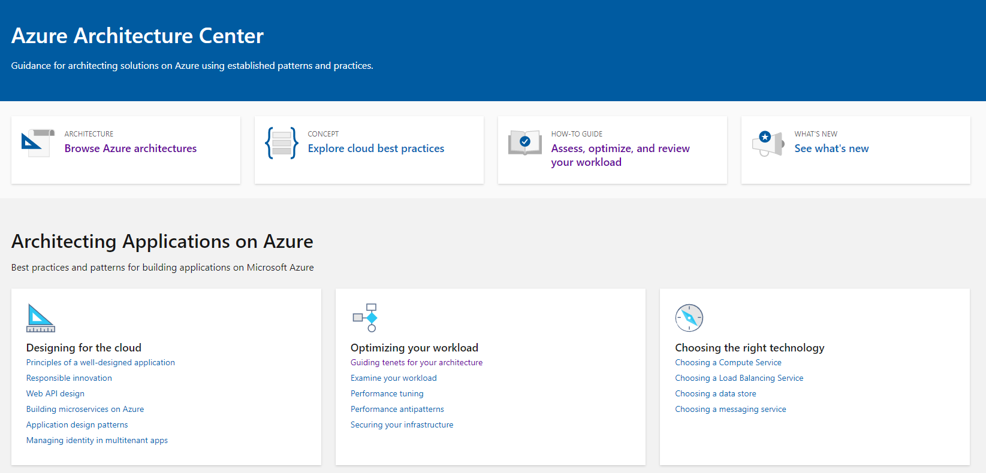

Azure Architecture Center
https://aka.ms/AzureAC
Microsoft Azure | @Techielass

Slide 19
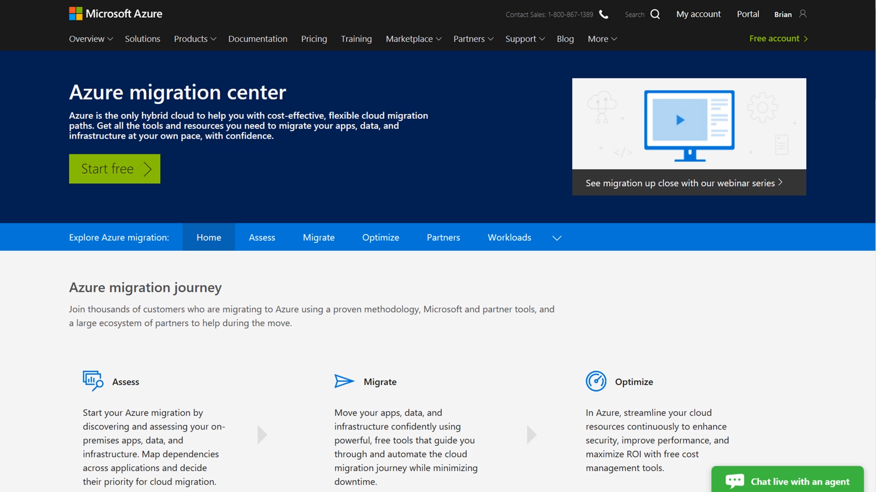
Azure migration center
Guidance
Tools
Partners
Migration journey and strategies
Right tools for the job
Migration experts
Azure.com/Migration

Slide 20

Thank you! Resources: https://aka.ms/migrate-talk-resources
Sarah Lean
Senior Cloud Advocate
@Techielass
www.techielass.com

